Slide 1
The Gtk.HeaderBar
...In combination with using Gtk.Builder and its XML data to build parts of a GUI, while other parts are built conventionally.
...evolving into something completely irrelevant, but more exciting.
Hamilton Python Users Group
Ian Stewart
2021-

Slide 2
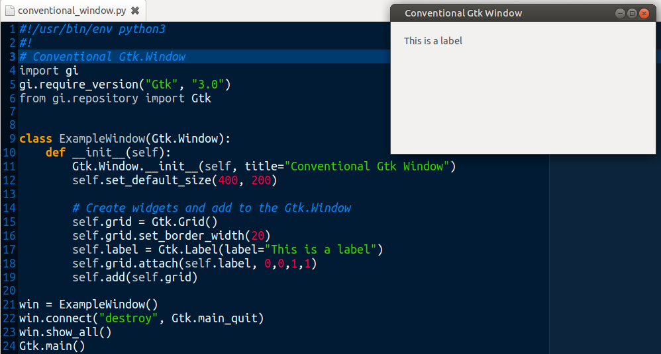
Gtk.Header ~ Gtk Window

Slide 3
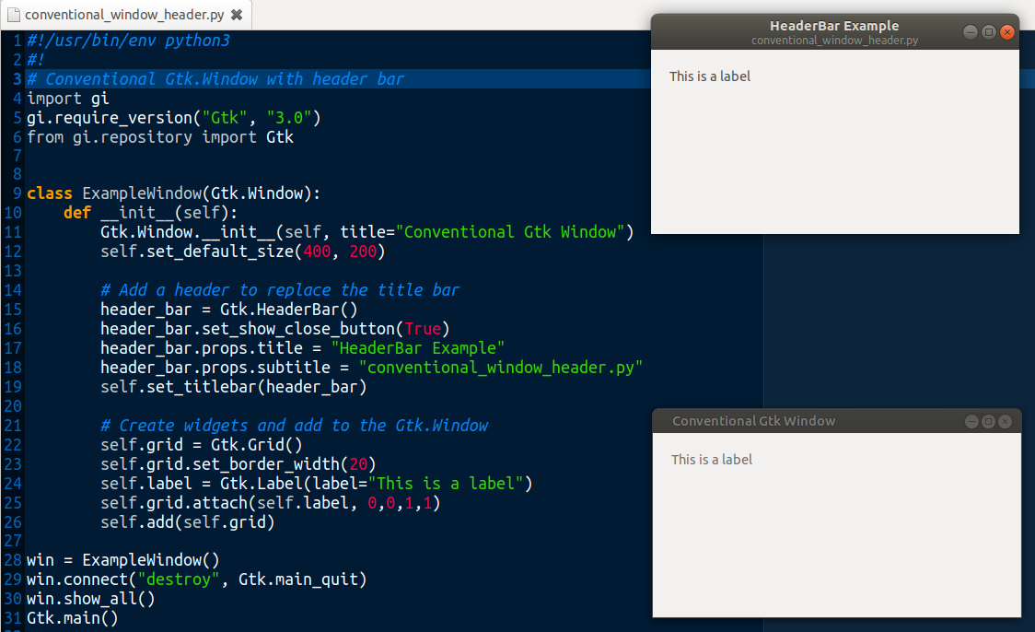
Gtk.Header ~ Gtk Window

Slide 4
Gtk.Header
Install Glade. As of 2021-05-10 at V3.38.1
Download from https://gitlab.gnome.org/GNOME/glade
Hard to start...
$ export LD_LIBRARY_PATH=~/.local/lib/x86_64-linux-gnu/ glade
$ GDK_BACKEND=x11 ./glade
(glade:3683): Gdk-WARNING **: 07:49:13.985: ../../../../../gdk/x11/gdkwindow-x11.c:5633 drawable is not a native X11 window
GladeUI-Message: 07:49:14.348: 1 missing displayable value for GtkCellRendererAccel::accel-mode
GladeUI-Message: 07:49:14.391: Glade needs artwork; a default icon will be used for the following classes:
GtkFileChooserNative needs an icon named 'widget-gtk-filechoosernative'
GThemedIcon needs an icon named 'widget-gtk-themedicon'
GladeInstantiableGtkBin needs an icon named 'widget-gtk-bin'
GFileIcon needs an icon named 'widget-gtk-fileicon'
GtkApplicationWindow needs an icon named 'widget-gtk-applicationwindow'

Slide 5
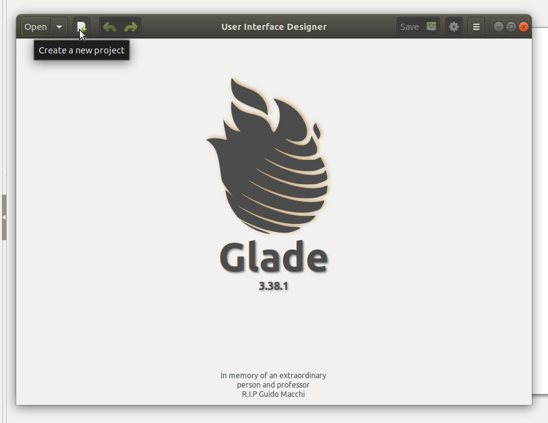
Gtk.Header ~ Create a new project

Slide 6
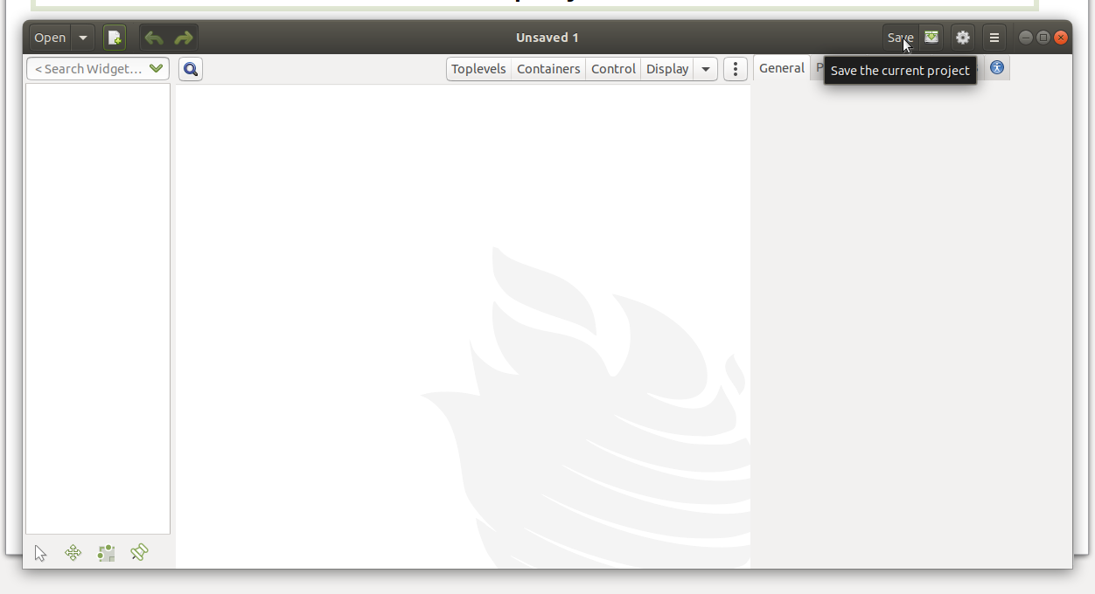
Gtk.Header ~ Create a new project

Slide 7
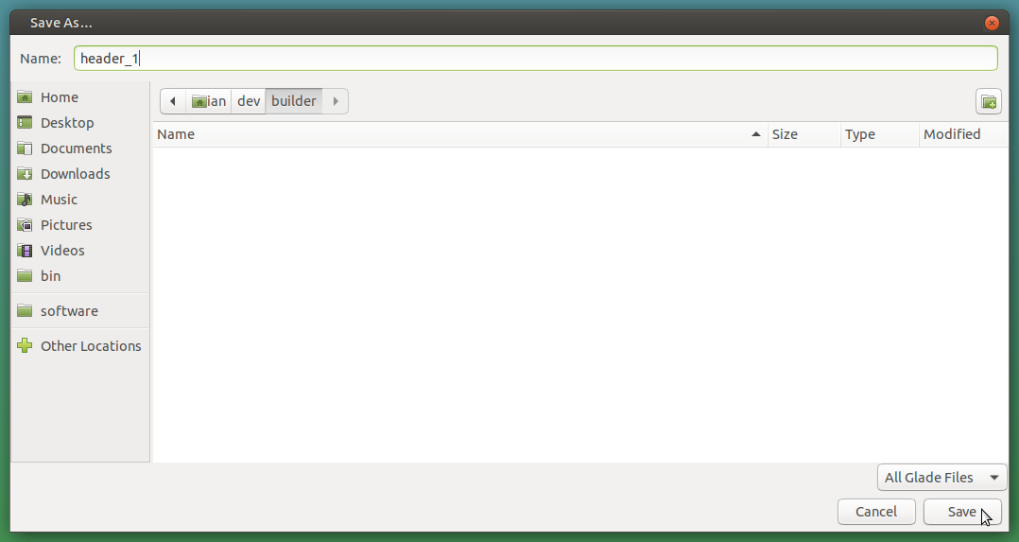
Gtk.Header ~ Create a new project

Slide 8
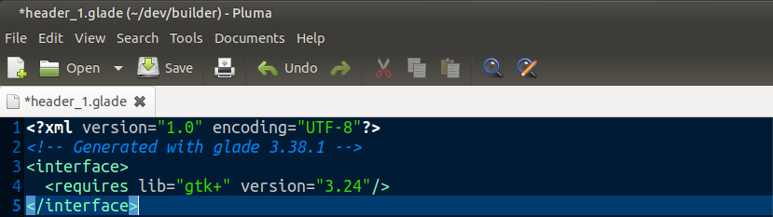
Gtk.Header ~ Contents of UI XML file: header_1.glade

Slide 9
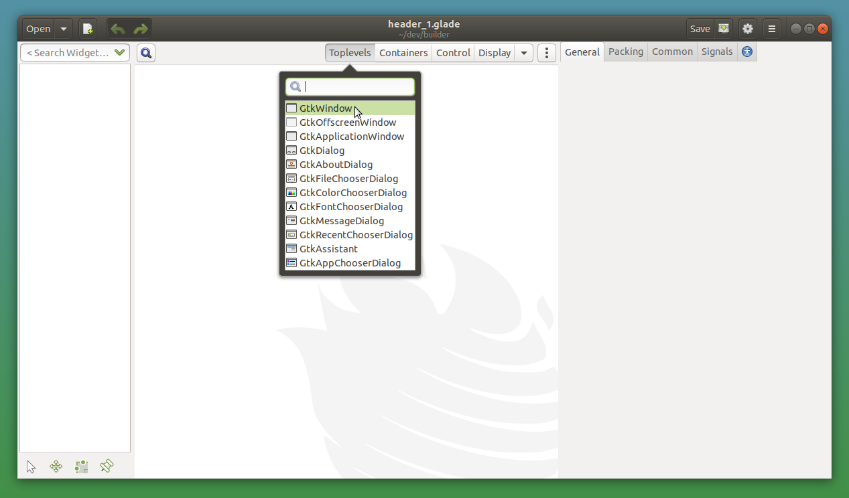
Gtk.Header ~ Contents of UI XML file: header_1.glade

Slide 10
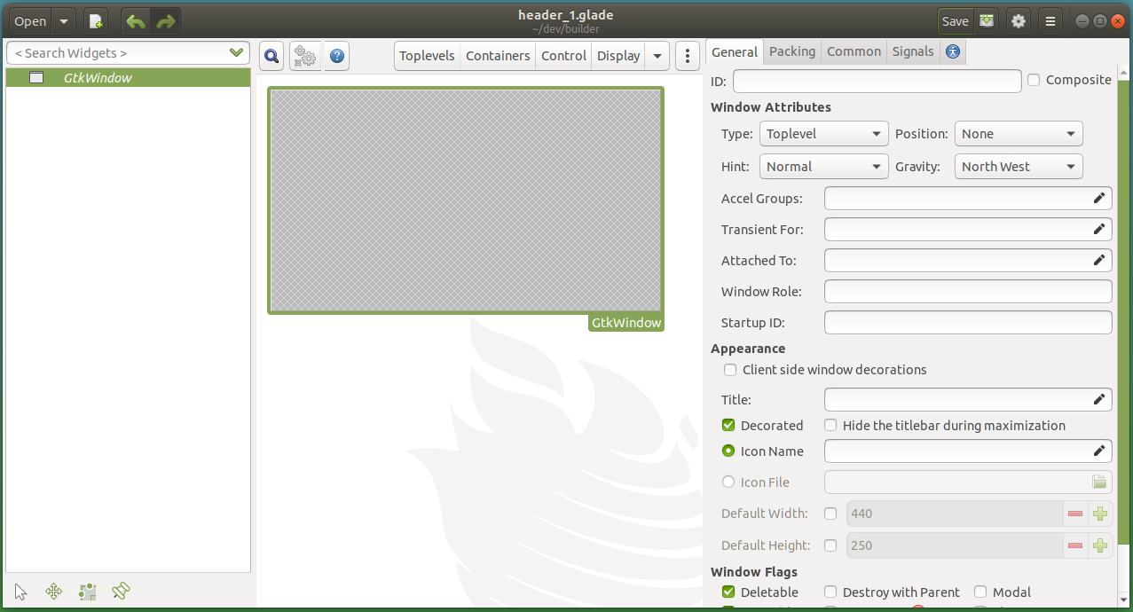
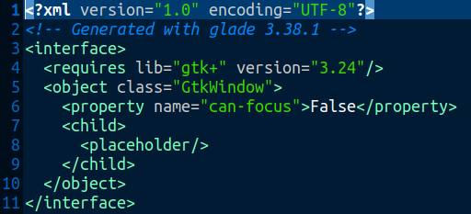
Gtk.Header ~ Add Gtk.Window.

Slide 11
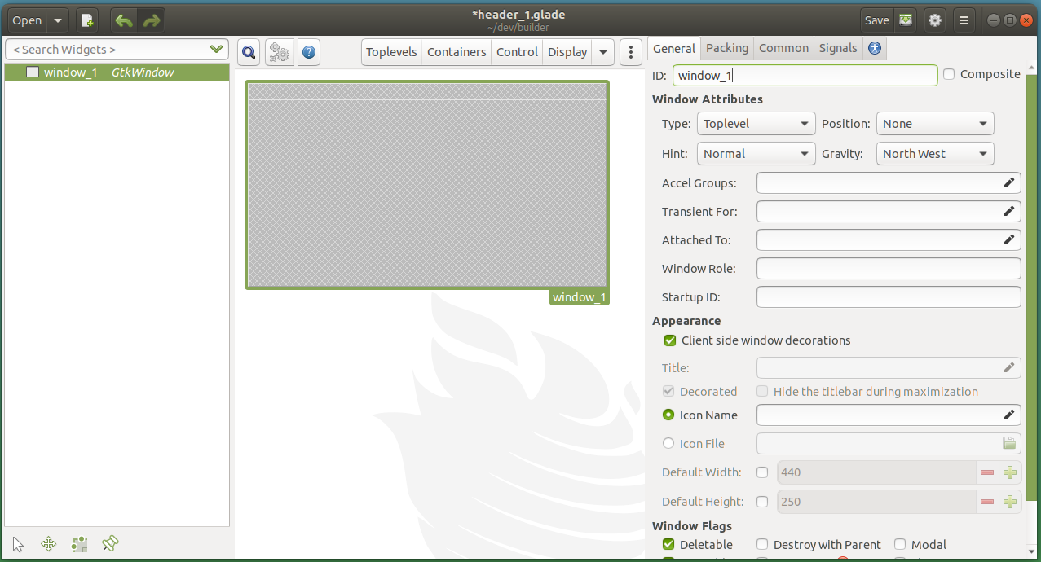
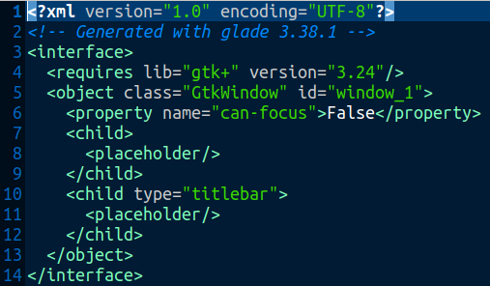
Add ID. Check Client side window decorations

Slide 12
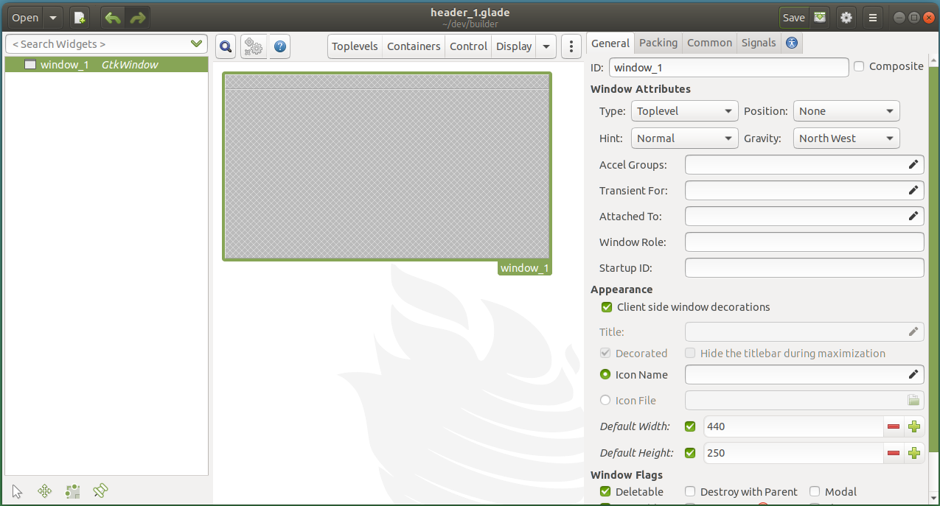
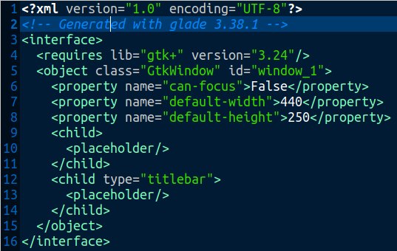
Check: Default Width & Default Height

Slide 13
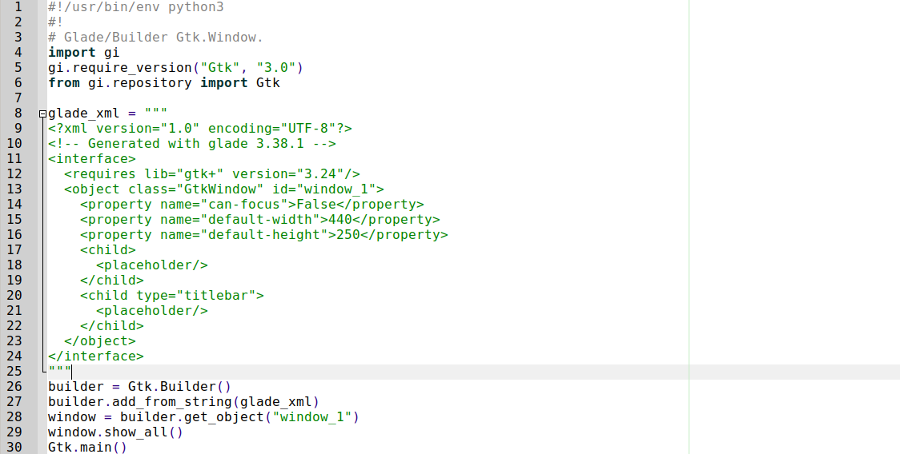
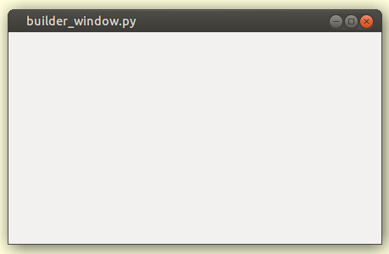
Using Gtk.Builder and the Glade xml data.

Slide 14
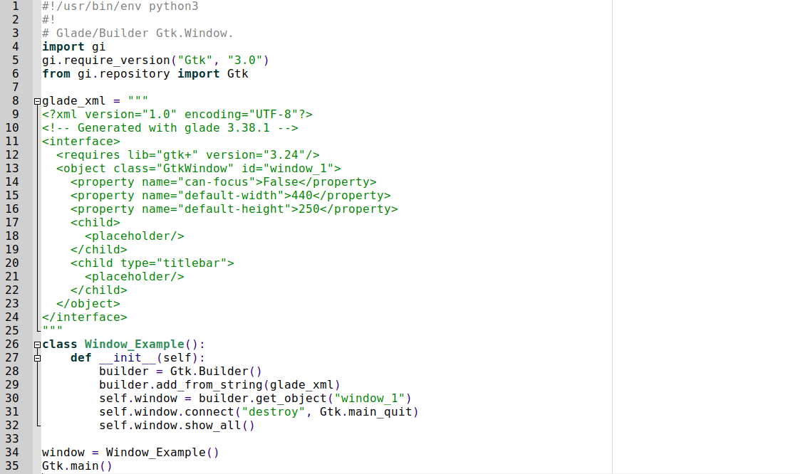
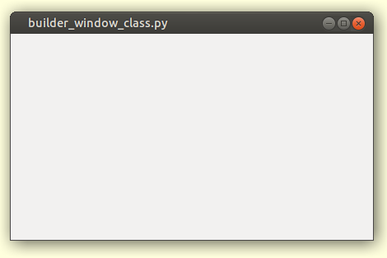
Place the code in a class.

Slide 15
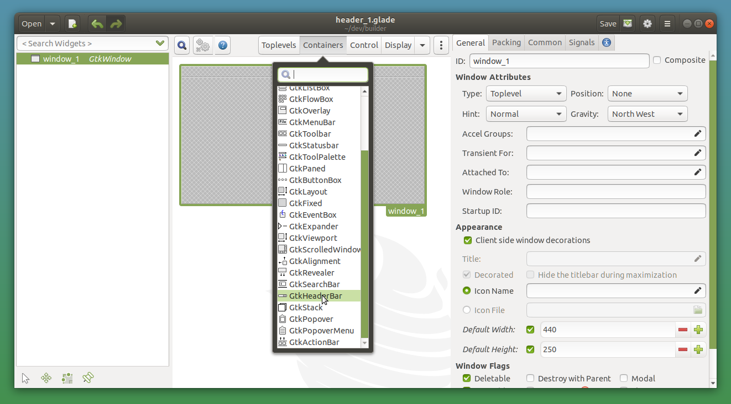
Add Gtk.HeaderBar.

Slide 16
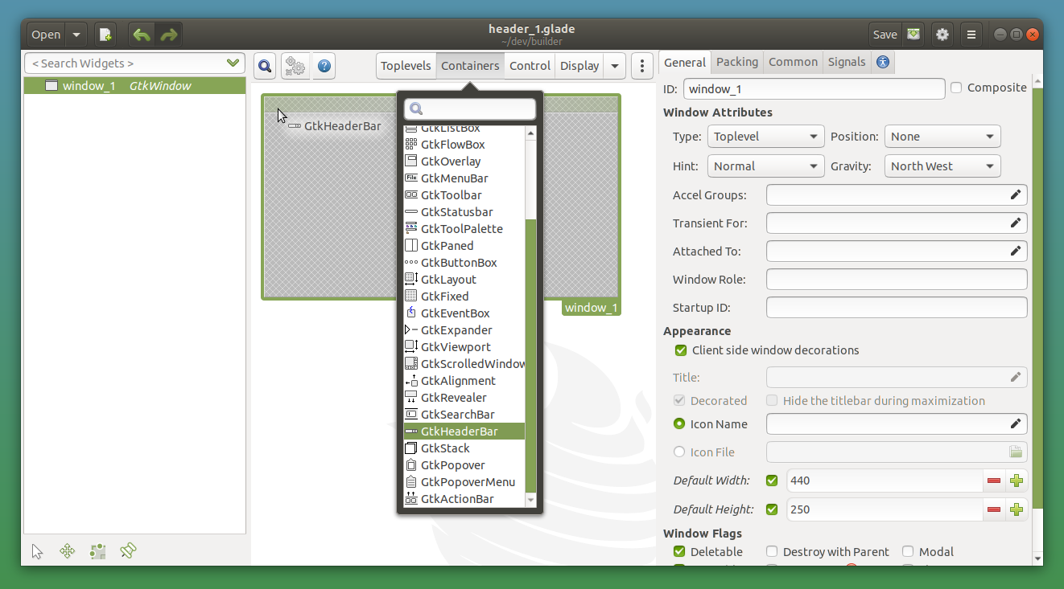
Place the code in a class.

Slide 17
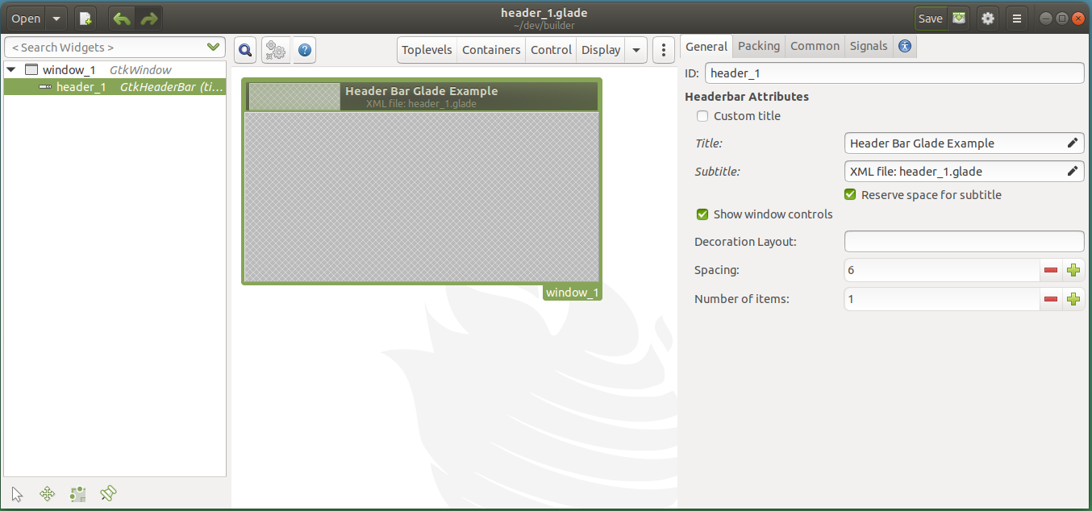
Place the code in a class.

Slide 18
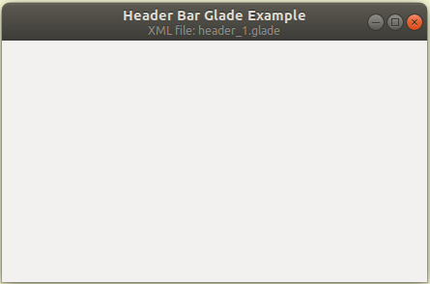
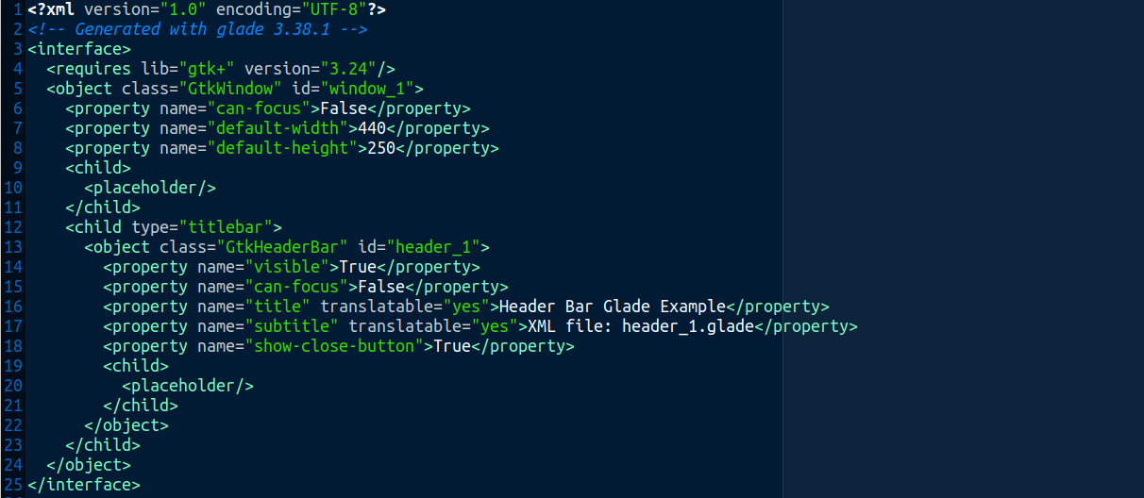
Glade XML with HeaderBar displaying title and sub-title.

Slide 19
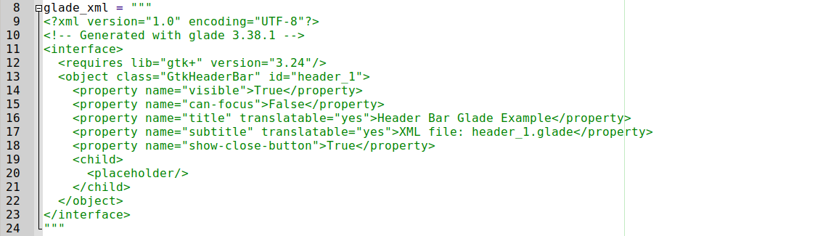
Glade xml. HeaderBar only. Gtk.Window removed.

Slide 20
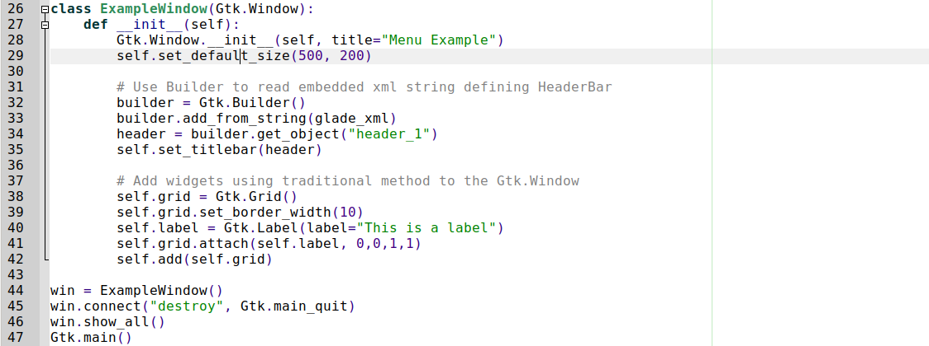
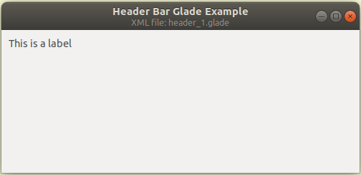
Gtk.Window Grid and Label. Also using builder for header.

Slide 21
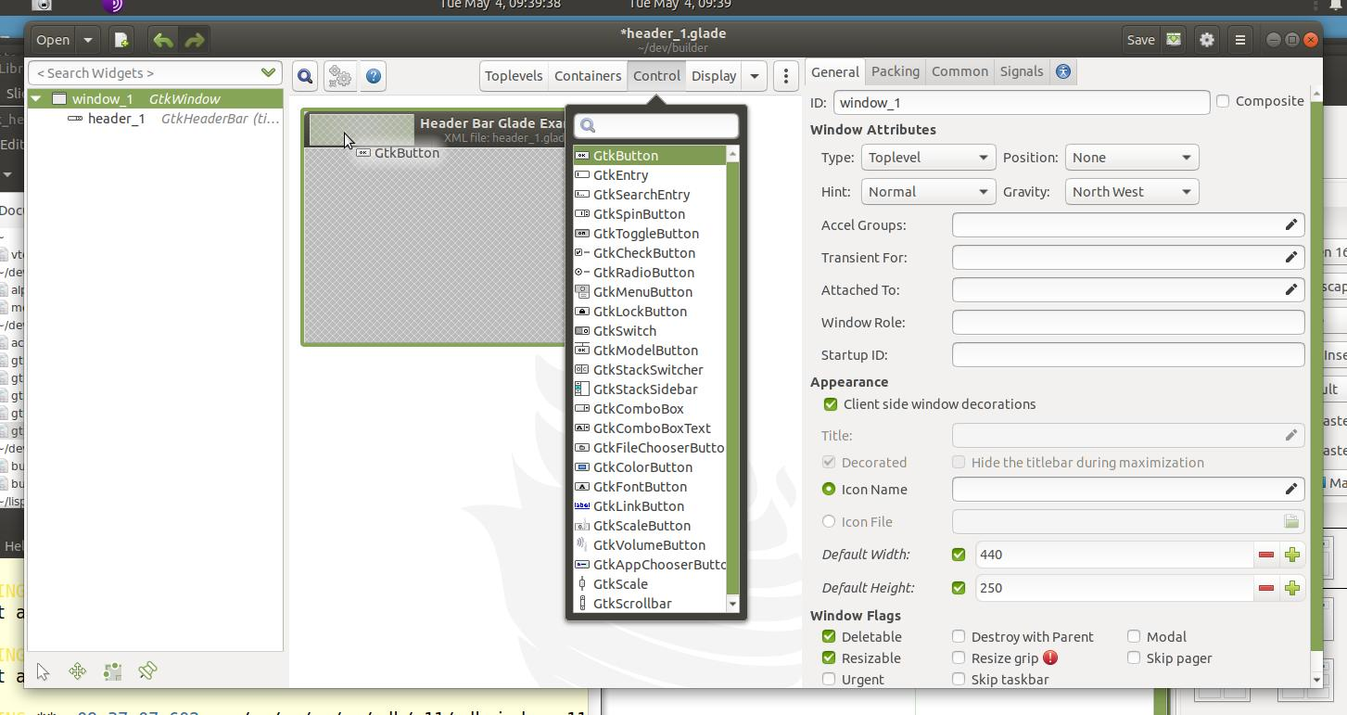
Add a button to the header bar.

Slide 22
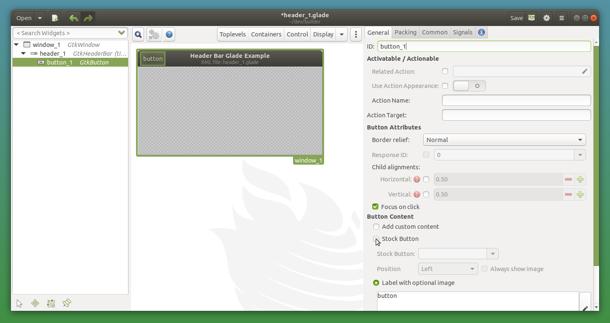
Button

Slide 23
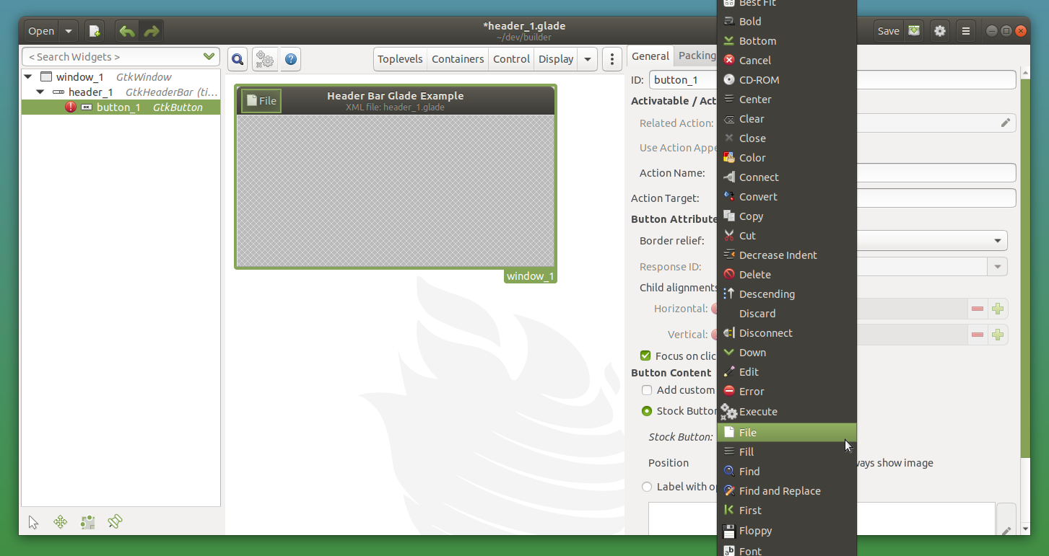
Gtk.Window Grid and Label. Also using builder for header.

Slide 24
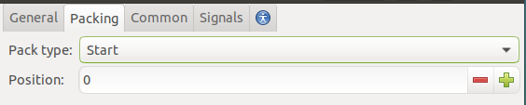
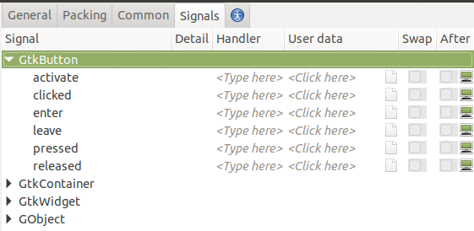
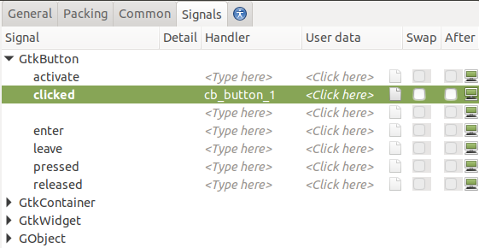
Gtk.Window Grid and Label. Also using builder for header.

Slide 25
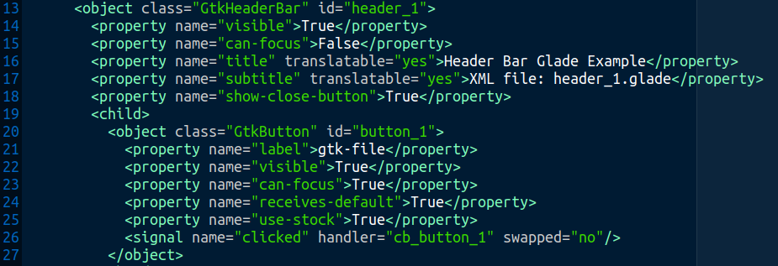
Additional XML for “file” button

Slide 26
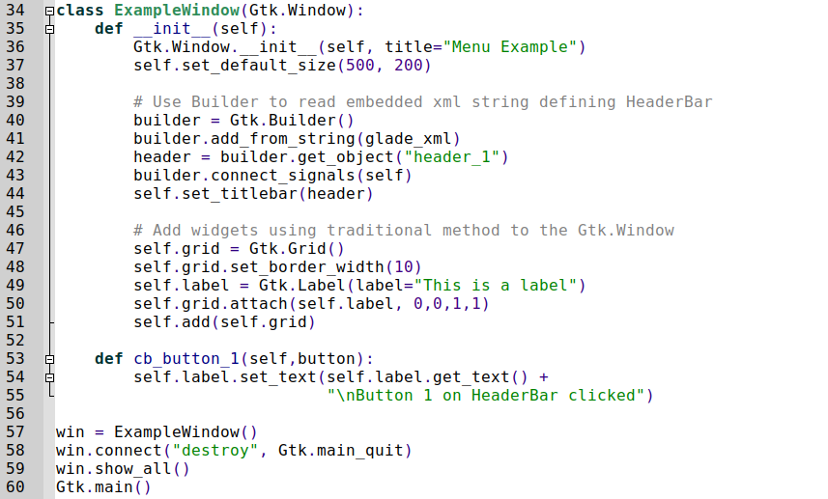
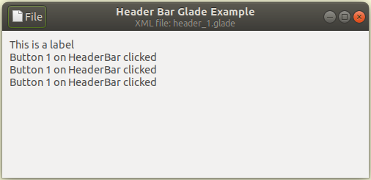
Builder connects signals. Provide method for button_1 “file”.

Slide 27
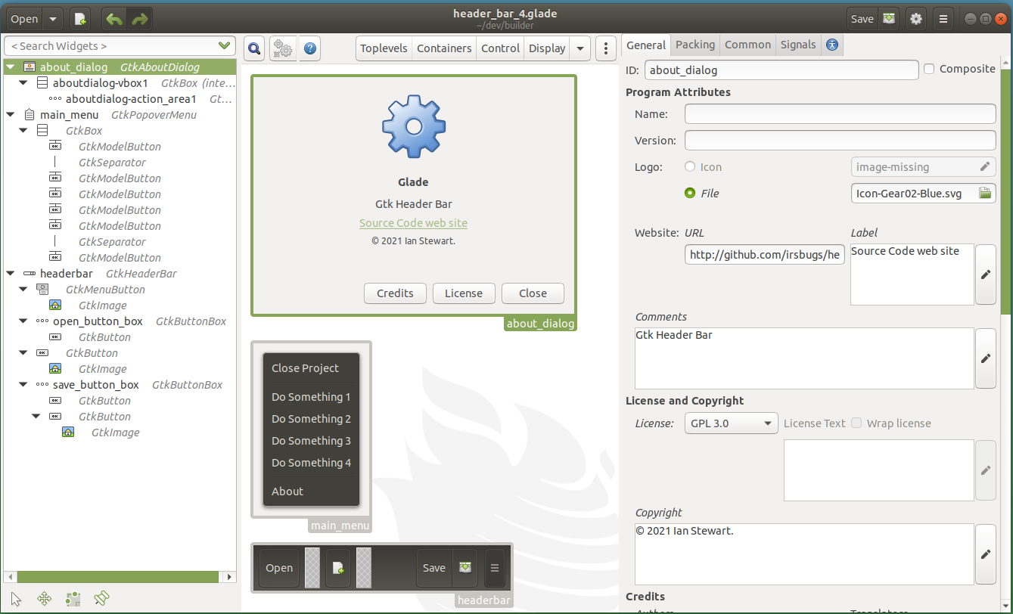
Glade designed components for Gtk.Builder to add.

Slide 28
Glade designed components for Gtk.Builder to add.
Review source code and Demo program.

Slide 29
End.

